Slide 1
Application of WRSS in Water and Energy Analysis; An object-oriented R package for large-scale water resources operation
Rezgar Arabzadeh
June 10th 2019
11:30 – 11:48
Ariane 1+2
Toulouse
France

Slide 2
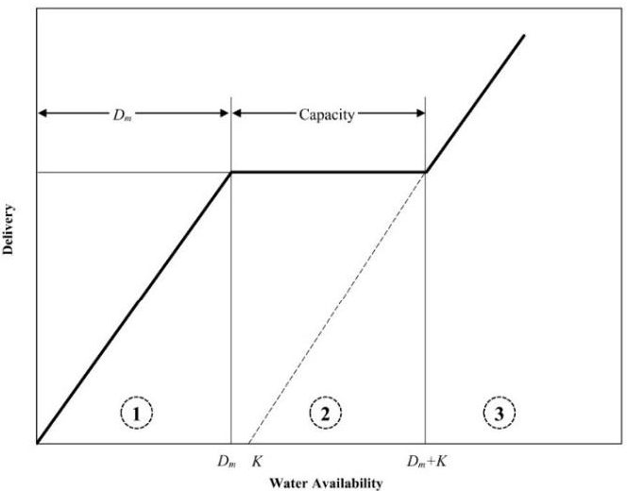
Overview
There are several commercial water resources models
The open-source models usually are incorporating single units.
There are some R packages concerning water systems modelling and operation, e.g.: reservoir, RSSOP, topmodel, hydromad, and etc.
WRSS (Water Resources System Simulator) suggests operation of large-scale water resources facilities together
There are different types of available facilities: reservoir, aquifer, river, and etc.
The package is established based on Standard Operating Policy (SOP)

Slide 3
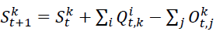
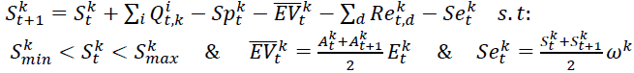
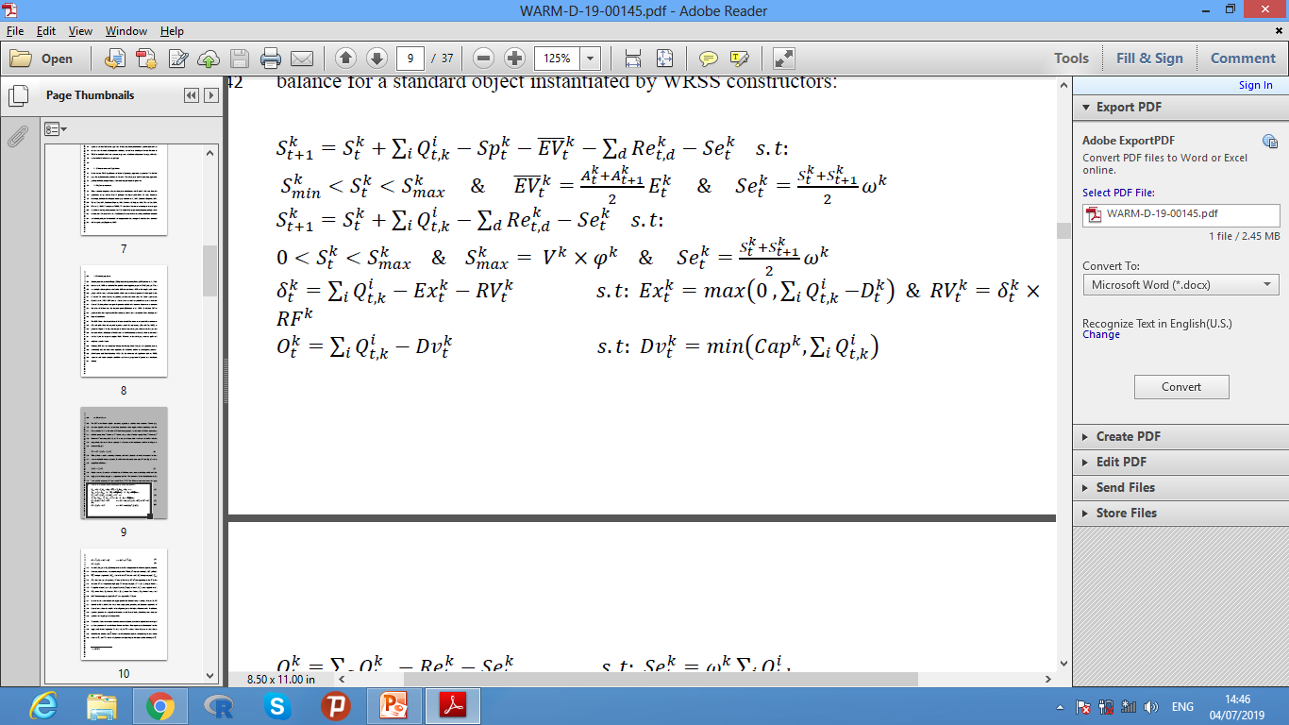
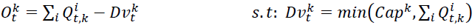

Capabilities and characteristics
Governing equations:
  Mass Balance:
  (General Equation)
(Reservoir)
(Aquifer)
(Diversion)
(Demand)
(Junction)

Slide 4
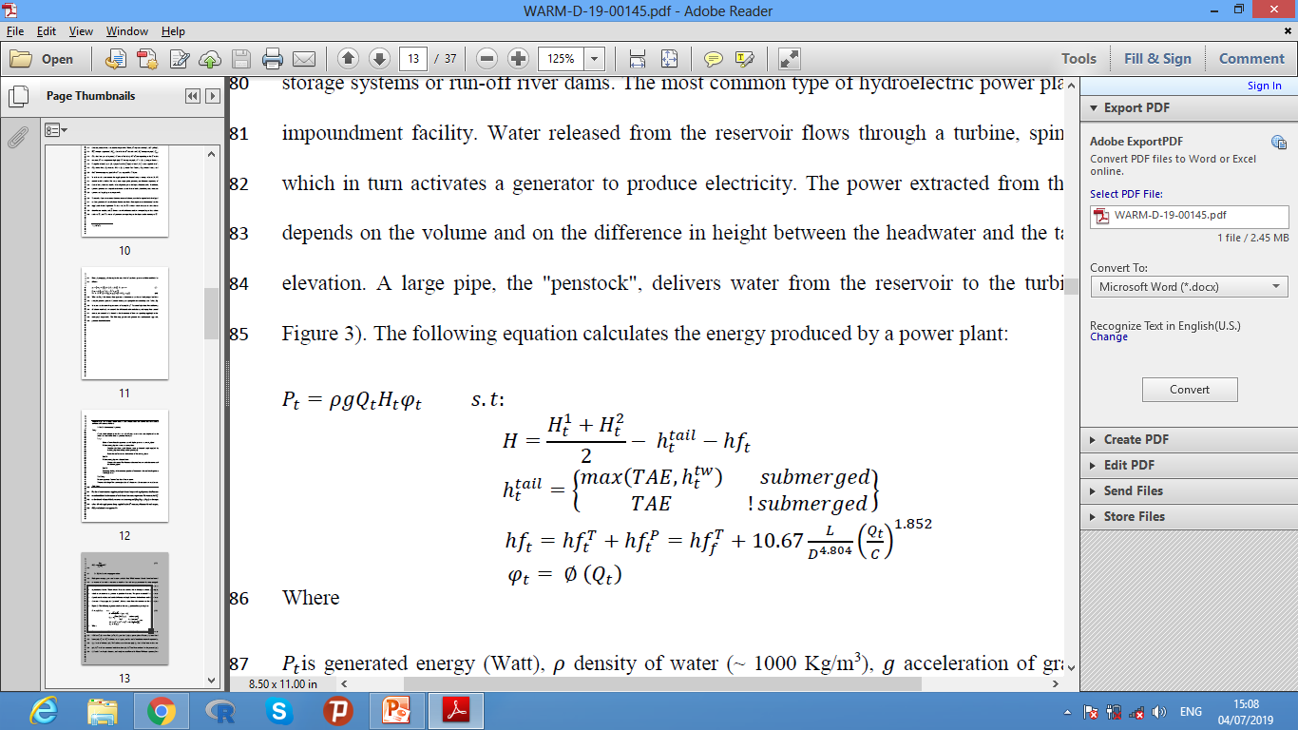
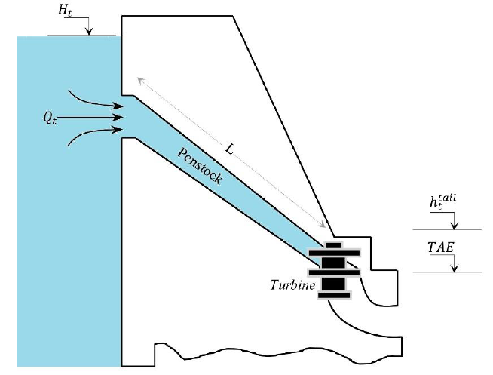
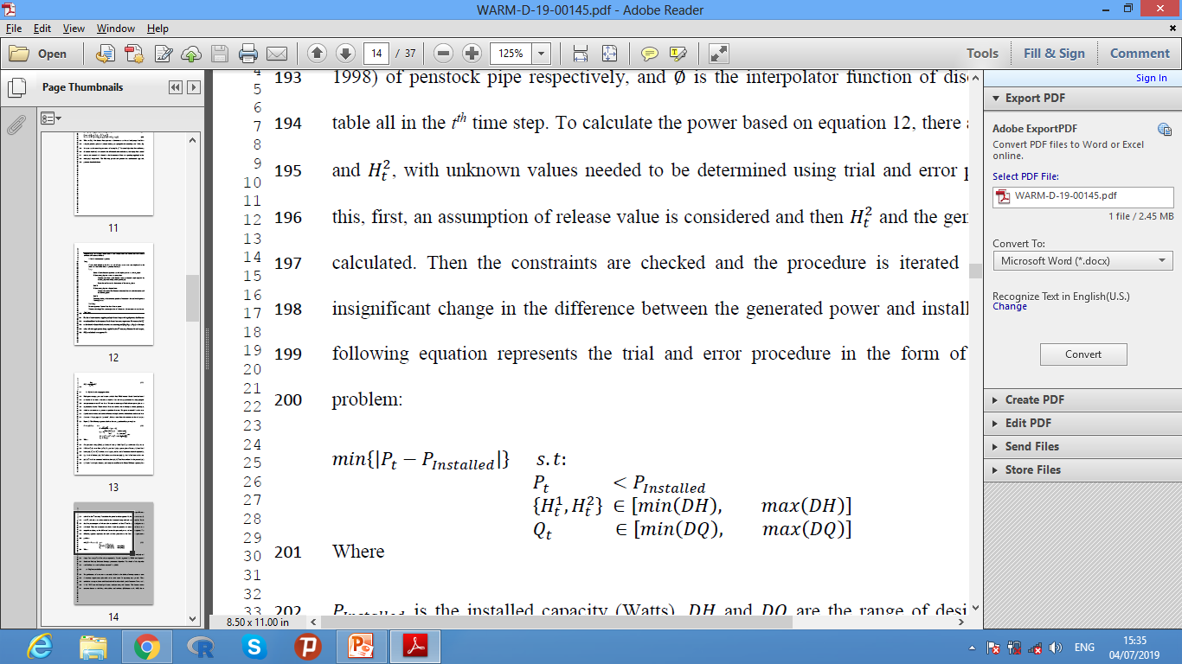
Capabilities and characteristics
Governing equations:
  Energy Generation

Slide 5
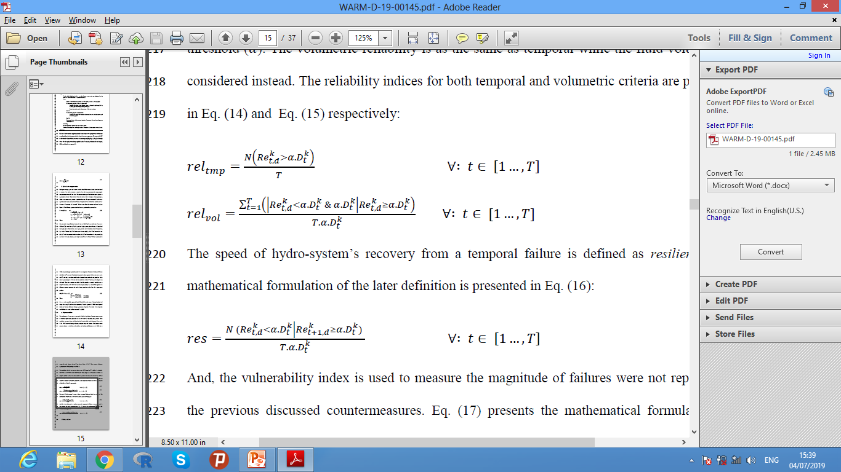
Capabilities and characteristics
Governing equations:
  Performance assessment

Slide 6
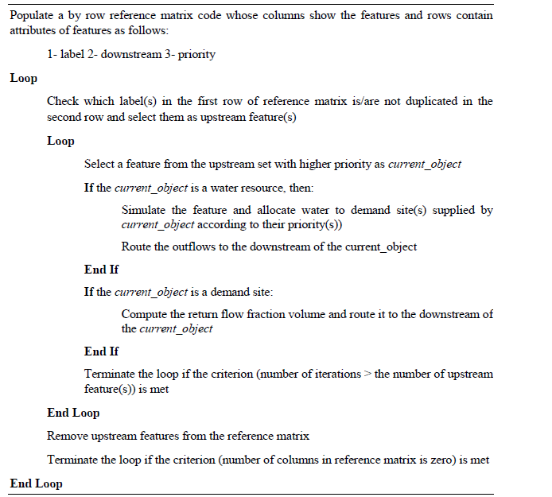
Capabilities and characteristics
Priorities, interaction and many more
  WRSS supports:
    Many water resources
    Water resources and demand nodes with equal priority
    Upstream – downstream direction detection
    Conjugative water allocation
    Features interaction by spillage, leakage, and seepage

Slide 7
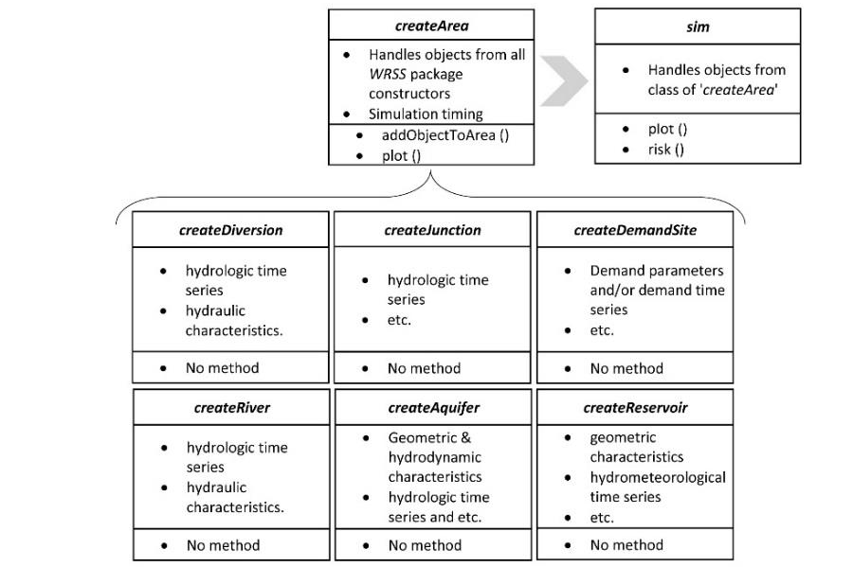
Capabilities and characteristics
S3 implementation
  The package is implemented based on S3
  There are classes for river-basin features constructions and classes for objects manipulations
  There are methods for working with the classes instances, e.g: plot, risk and etc.

Slide 8
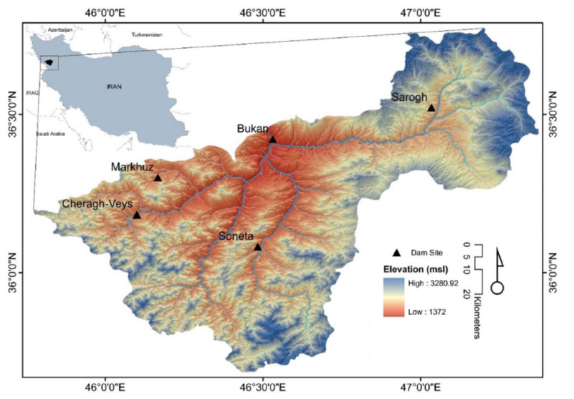
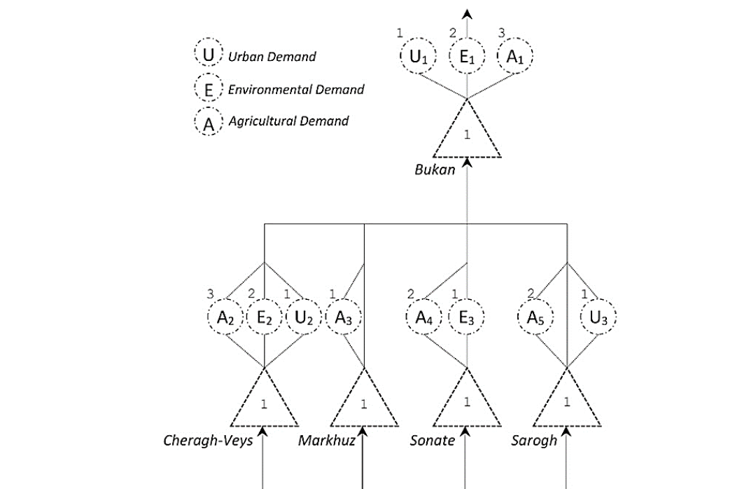
Case Study
Zerrine-rud river basin
  Location: Kurdistan, Iran
  Area: 4700 sq²
  Precipitation: 510 ^{mm}/_{year}
  Temperature: 9.2 ^{O}C
  Source: Iran Water Resources Management Company
  Total runoff: 1665.8 × 10⁶ m³/year
  Simulation Period: 10 years
  Time interval: monthly
Single Unit Scenario
Large-scale Scenario

Slide 9
Results
Single Unit Scenario
29.8 % operation coefficient
Allocation Priority
1 2 3
 | E1 | U1 | A1
Vulnerability | 10.76 | 17.12 | 26.84
Reliability | 0.90 | 0.81 | 0.77
Resiliency | 0.33 | 0.30 | 0.25

Slide 10
Results
Large-scale Scenario
34.2 % operation coefficient
Single Unit
 | E1 | U1 | A1
Vulnerability | 10.76 | 17.12 | 26.84
Reliability | 0.90 | 0.81 | 0.77
Resiliency | 0.33 | 0.30 | 0.25
Large-scale
 | E1 | U1 | A1
Vulnerability | 0.14 | 13.57 | 19.47
Reliability | 0.99 | 0.85 | 0.83
Resiliency | 1.00 | 0.33 | 0.30

Slide 11
Conclusion
An object-oriented R package which supports simulation of large-scale supply water resources systems with complex layouts
Detect supply and allocation priorities for both water resources objects and demand nodes
Covers a range of water resources features with capabilities such as recharging other features by different mechanism
There are similar commercial software packages with similar possibilities, however, WRSS suggests the tools to evaluate water resources freely

Slide 12
Thank YOU!
QUESTIONS…

